Slide 1
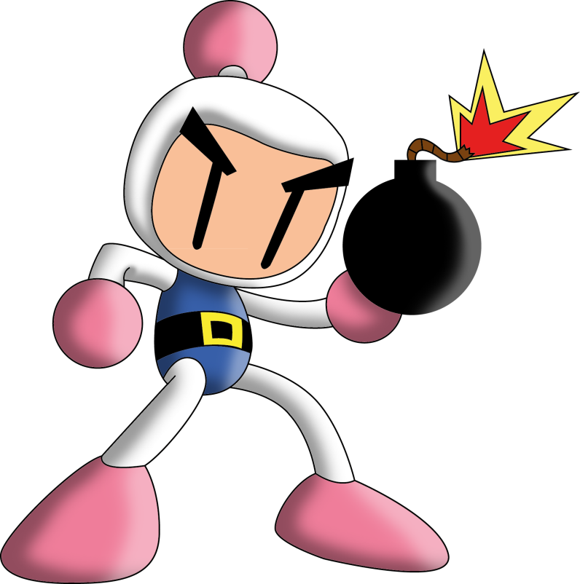
BOMBER MAN

Slide 2
BOMBER MAN TEAM
Team Member #1 Ojas Gupta
(140040016)
Team Member #2 Prathu Baronia
(14D070046)
Team Member #3 Rohan Bukte
(14D070035)

Slide 3
PROBLEM STATEMENT
First we had to design levels of the game by using two dimensional arrays in accordance to the orignal bomberman game.
Then we had to make the enemy movement totally random so that the user can’t deduce any pattern.
We had to take input from the keyboard keys for bomberman’s movement .
The Bomberman could be killed by its own bomb or by
coming in contact with enemy which is a crtical part of the gameplay.
Bomberman’s mission is to kill all the enemies and collect the key and walk through the door to cross the level.

Slide 4
CHALLENGE
Our first major challenge is that bomberman is not getting killed when he comes in contact which we haven’t solved as of now.
Our second problem which is also unsolved as of now is that our key is shown even if only one out of 3 enemies is killed.We are not able to figure out the bug yet.

Slide 5
FUTURE WORK
We are planning to extend this game to a 3-D version where we can have projectile motion bombing i.e. just like throwing grenades.
As this is a vintage game and as this is played by mostly young children so we like to make a user friendly and a well designed GUI.
This could well be extended to a multiplayer version
where a group of users can fight against the enemies
by bombing their stations just like CounterStrike.

Slide 6
EXPERIENCE IT
We think rest all should be presented in a video, which is the best way to represent !

